Slide 1
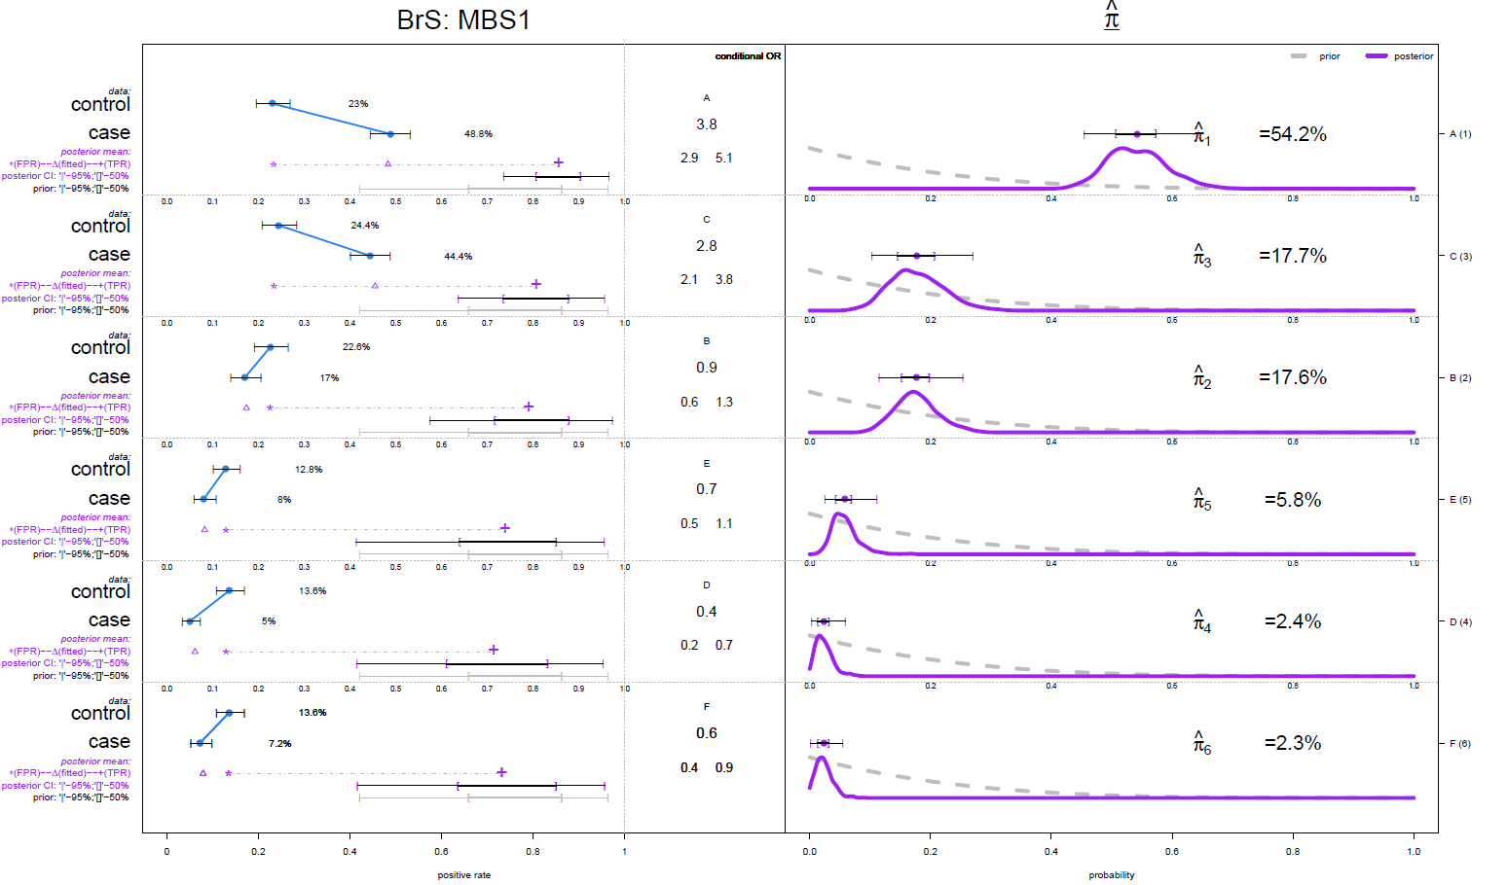
plot_panels(result_folder,bg_color=NULL)

Slide 2
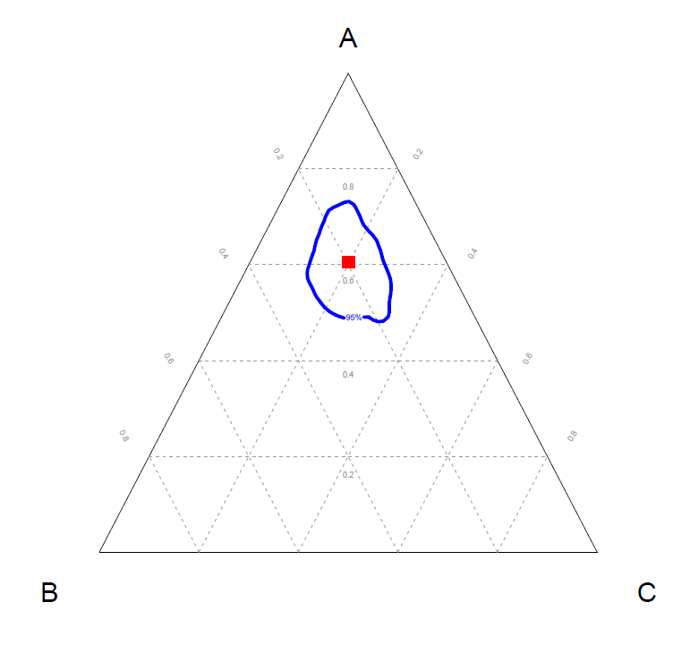
plot_selected_etiology(selected = c("A","B","C"), result_folder, 1, 5)

Slide 3
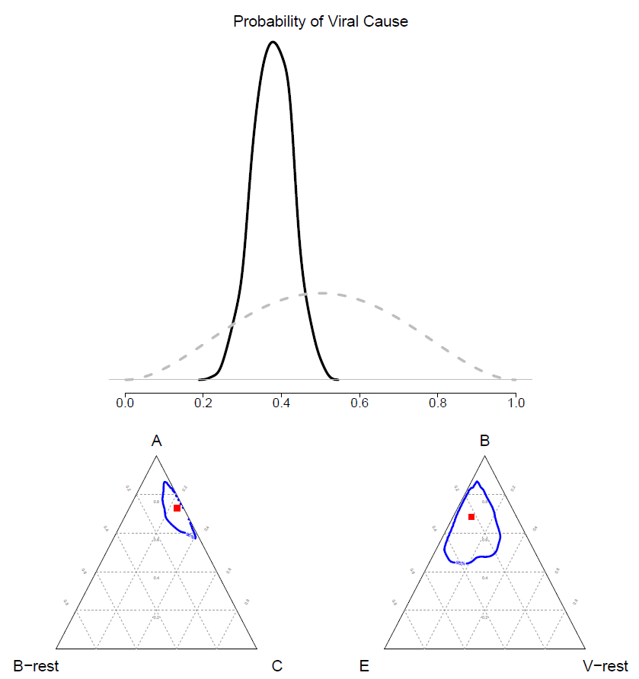
plot_group_etiology(result_folder,dir_taxo = file.path(working_dir,
"pathogen_category_simulation.csv"))

Slide 4
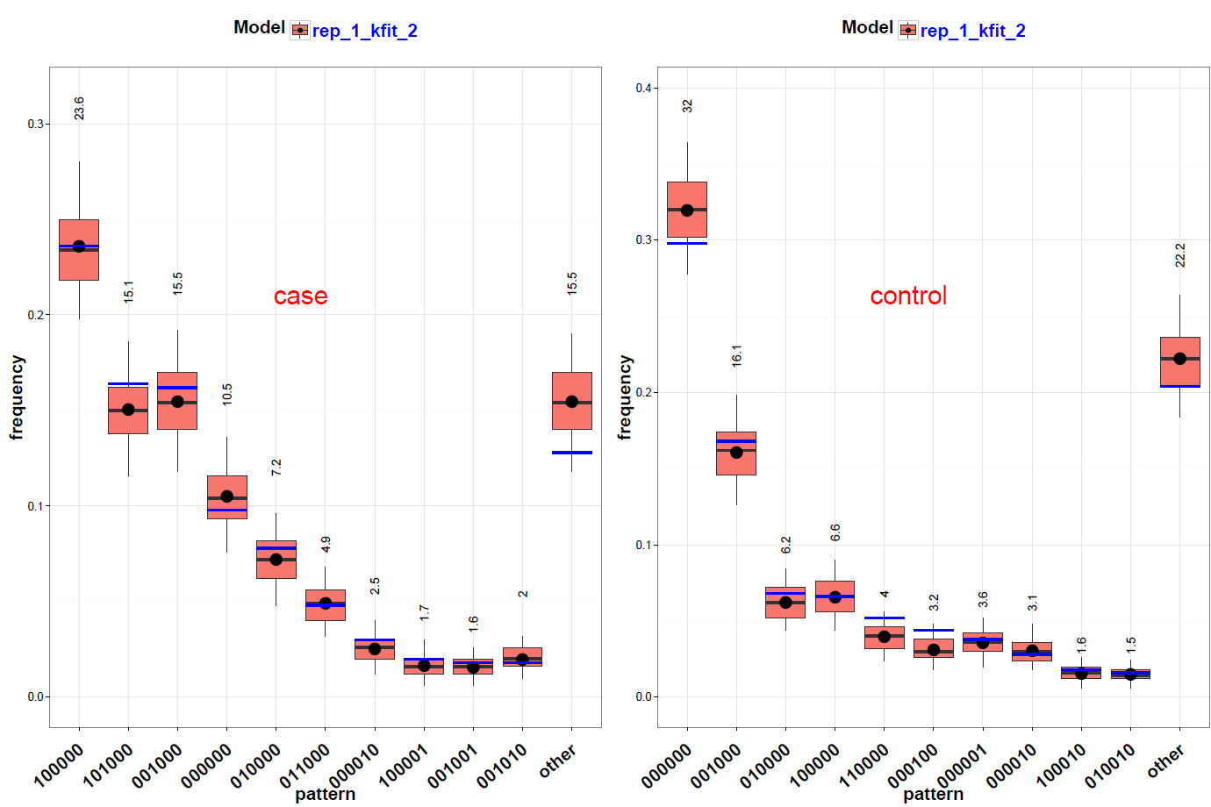
plot_check_common_pattern(dir_list,slice_vec =c(1,1))

